Slide 1


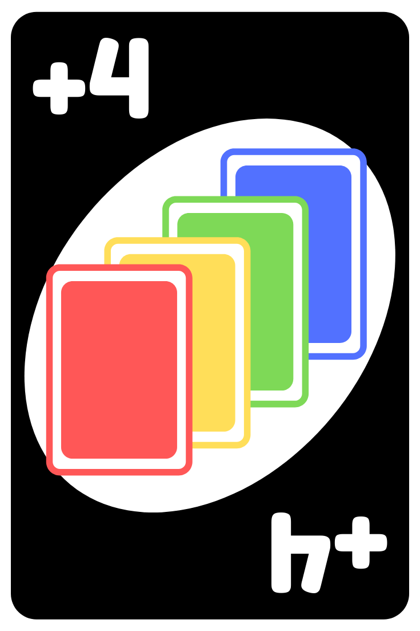
Proofs with Uno

Slide 2
Proofs are written in Two-Column Form
Deductive reasoning is used to prove a statement is correct.
Step by step ideas must be laid out with postulates or proven theorems to prove a statement.

Slide 3
Postulates and Theorems
Postulates are big ideas that are accepted as universal truths without proof.
Theorems are ideas that can be proven using deductive logic (through syllogisms).

Slide 4
Format of Two-Column Proofs:
Write the Given information Given, and what is to be proved.
Construct a T.
Statements that are true are placed in the first column.
Reasons why the statement is true is placed in the second column.

Slide 5
Writing Uno Proofs
The postulates are the rules of Uno.
The first card is the Given.
Syllogistic logic is used to list the order in which cards are played to finally play the card to be Proved.
The logic in justified in 2-column format.

Slide 6
3 Postulates of Uno!
Play the same color card.
Play the same number card.
Play a WILD card to change color.

Slide 7





Sample
Begin with
List how to play these cards to
‘Prove’

Slide 8
T-Chart
Card played Reason__________
1. Blue 6 ▐ 1. Given
2. Blue Skip ▐ 2. Same Color
3. Wild Draw 4 ▐ 3. Change Color
4. Yellow 5 ▐ 4. Same Color
5. Yellow 1 ▐ 5. Same Color
6. Yellow Reverse ▐ 6. Same Color

Slide 9




Given
Not every postulate has to be used.
Same Symbol Change Color Same Color Same Color
Same Color

Slide 10
T-Chart
Given: Red R Prove: Red 9
Card played Reason
---------------------------------------------------------------------
1. Red Reverse ▐ 1. Given
2. Yellow Reverse ▐ 2. Same Symbol
3. Wild Draw 4 ▐ 3. Change Color
4. Blue 9 ▐ 4. Same Color
5. Red 9 ▐ 5. Same Number
No need to use Blue

Slide 11




Given:
Prove:
Using:

Slide 12
T-Chart
Given: Yellow 1 Prove: Red 2
Statements Reasons
----------------------------------------------------------
1. Yellow 1 ▐ 1. Given
2. Yellow 0 ▐ 2. Same Color
3. Red 0 ▐ 3. Same Number
4. Red 2 ▐ 4. Same Color

Slide 13





Given:
Prove:
Using:

Slide 14
T-Chart
Given: Blue Seven Prove: Red Nine
Statements : Reasons:
---------------------------------------------------------------------
1. Blue 2 ▐ 1. Given
2. Blue Draw 2 ▐ 2. Same Color
3. Green Draw 2 ▐ 3. Same Symbol
4. Wild Card ▐ 4. Change Color
5. Blue 1 ▐ 5. Same Color
6. Red 1 ▐ 6. Same Number

Slide 15




Given:
Prove:
Using:

Slide 16
T-Chart
Given: Red 1 Prove: Green 3
Statements Reasons
---------------------------------------------------------------------
1. Red 1 ▐ 1. Given
2. Red Draw 2 ▐ 2. Same Color
3. Red Draw 2 ▐ 3. Same Symbol
4. Wild ▐ 4. Change Color
5. Green 7 ▐ 5. Same Color
6. Green 3 ▐ 6. Same Color

Slide 17

Given:
Prove:
Using:

Slide 18
T-Chart
Given: Green Draw 2 Prove: Blue Skip
Statements (What Card to Play): Reasons (I can play this card because):
---------------------------------------------------------------------
1. Green Draw 2 ▐ 1. Given
2. Green 9 ▐ 2. Same Color
3. Blue 9 ▐ 3. Same Number
4. Blue Skip ▐ 4. Same Color
The Red 9 does not have to be used. (It is ok to do so, but would require an additional step.)

Slide 19



Given:
Prove:
Using:

Slide 20
T-Chart
Given: Blue 9 Prove: Red 2
Statements: Reasons:
---------------------------------------------------------------------
1. Blue 9 ▐ 1. Given
2. Blue Draw 2 ▐ 2. Same Color
3. Green Draw 2 ▐ 3. Same Symbol
4. Green 6 ▐ 4. Same Color
5. Red 6 ▐ 5. Same Number
6. Red 2 ▐ 6. Same Color
Not all of the cards were used.

