Slide 1
Proving Triangles Congruent
UNIT 4 LESSON 2

Slide 2
The Idea of a Congruence
Two geometric figures with exactly the same size and shape.
F
B
A
C
E
D

Slide 3
How much do you need to know about two triangles to prove that they
are congruent?

Slide 4
Reflexive Property of Congruence
A segment is congruent to itself.
An angle is congruent to itself.

Slide 5
Side-Side-Side (SSS)
Postulate:
If three sides of one triangle are congruent to three sides of another triangle, then the two triangles are congruent.

Slide 6
Side-Side-Side (SSS)
B
E
F
A
C
D
AB ≅ DE
BC ≅ EF
AC ≅ DF
ΔABC ≅ Δ DEF

Slide 7
Side-Angle-Side (SAS)
Postulate:
If two sides and the included angle of one triangle are congruent to two sides and the included angle of another triangle, then the two triangles are congruent.

Slide 8
Side-Angle-Side (SAS)
B
E
F
A
C
D
AB ≅ DE
∠A ≅ ∠ D
AC ≅ DF
ΔABC ≅ Δ DEF
included
angle

Slide 9
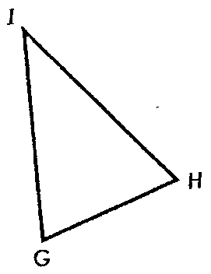
Included Angle
The angle between two sides
∠ G
∠ I
∠ H

Slide 10
Included Angle
E
Name the included angle:
YE and ES
ES and YS
YS and YE
∠ E
∠ S
∠ Y
Y
S

Slide 11
Included Side
The side between two angles
GI
HI
GH

Slide 12
Included Side
E
Name the included angle:
∠Y and ∠E
∠E and ∠S
∠S and ∠Y
YE
ES
Y
S
SY

Slide 13
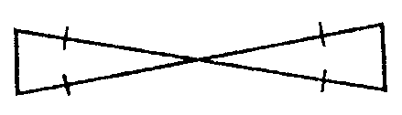
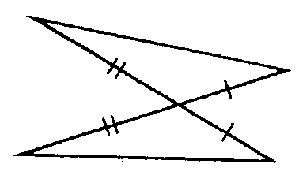
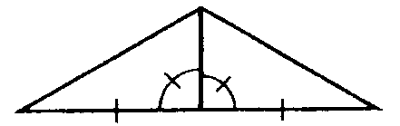
How are the triangles congruent?
Vertical Angles
Reflexive Property
SAS
SAS
Vertical Angles
SAS

