Slide 1
CLASSIFYING POLYGONS
Unit 1 Lesson 6

Slide 2
Classifying Polygons
In geometry, a figure that lies in a plane is called a plane figure.
A polygon is a closed plane figure formed by three or more segments. Each segment intersects exactly two other segments at their endpoints. No two segments with a a common endpoint or collinear. Each segment is called a side. Each endpoint is called a vertex.

Slide 3
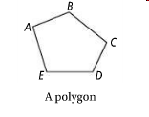
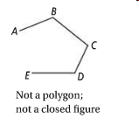
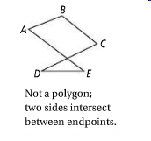


Classifying Polygons

Slide 4
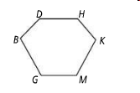
Classifying Polygons
To name a polygon, start at any vertex and list the vertices consecutively in a clockwise or counterclockwise direction.
Two names for this polygon are DHKMGB and MKHDBG.

Slide 5
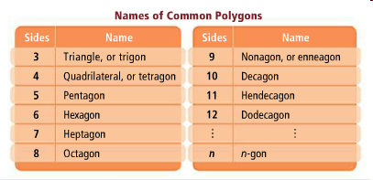
Classifying Polygons
You can classify a polygon by its number of sides. The tables below show the names of some common polygons.

Slide 6


Classifying Polygons
You can also classify a polygon as concave or convex, using the diagonals of the polygon.
A diagonal is a segment that connects two NONconsecutive vertices.
A Concave polygon has at least one diagonal with points outside of the polygon
A Convex polygon has no diagonal with points outside of the polygon

