Slide 1
Exploring Angle Pairs
Unit 1 Lesson 5

Slide 2
Exploring Angle Pairs
Students will be able to:
identify special angle pairs and use their relationships to find angle measures.
Key Vocabulary
Complementary and Supplementary angles
Vertical angles
Adjacent angles
Corresponding angles
Linear pair
Alternate angles

Slide 3
Measuring Angles
An angle is a measure of the turn between two lines that have a
common end point. The rotation is measured in the anti-clockwise
direction.
The two lines form the sides of an angle.
The point where two lines are meeting is called the vertex.
The angle is represented by a symbol along with a letter.
Sides
Vertex
A

Slide 4
Measuring Angles
Two angles are said to be complementary angles if their sum is 90 degrees.
The angles A and B shown in the figure are complementary since their angle sum is 90°.
A + B = 90°
B
A

Slide 5
Measuring Angles
Two angles are said to be supplementary angles if their sum is 180 degrees.
The angles A and B shown in the figure are complementary since their angle sum is 180°.
A + B = 180°
B
A

Slide 6
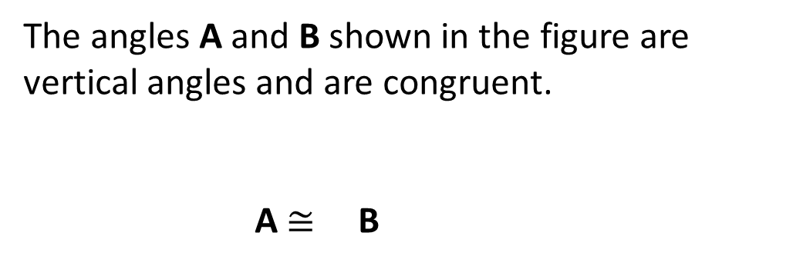
Measuring Angles
Vertical angles are the angles opposite to each to each when two lines are crossed. The two vertical angles are congruent.
The angles A and B shown in the figure are vertical angles and are congruent.
A $≅$ B
B
A

Slide 7
Measuring Angles
Adjacent angles are the angles having a common side and a common vertex.
The angles A and B shown in the figure are adjacent angles.
B
A
A is adjacent to
B

Slide 8
Measuring Angles
A linear pair of angle is formed when two lines intersect each other. Two angles are linear if they are adjacent angles formed by two intersecting lines.
The angles A and B shown in the figure are adjacent angles and also a linear pair.
B
A
A and
B are linear

Slide 9


Measuring Angles
When two coplanar lines are crossed by a 3rd line (called the transversal), then the angles formed on the opposite sides of the transversal are called alternate angles.
The pair of angles on the opposite side of the transversal but inside the two coplanar lines are alternate interior angles (angles A and B in the figure).
The pair of angles on the opposite side of the transversal but outside the two coplanar lines are alternate exterior angles (angles C and D in the figure).
If a transversal intersects two parallel lines, then the alternate angles are congruent.
D
A
B
C
A $≅$
C $≅$
D
B and

Slide 10


Measuring Angles
When two coplanar lines are crossed by a 3rd line (called the transversal), then the angles formed on the same sides of the transversal are called corresponding angles.
The angles A and B, and angles C and D are the pair of corresponding angles.
If a transversal intersects two parallel lines, then the corresponding angles are congruent.
A
C
B
D
A $≅$
C $≅$
D
B and

Slide 11
Measuring Angles
Problem 1:
Identify all the pair of alternate, vertical and corresponding angles in the figure shown below.
Alternate angles: angles a and h, b and g, c and f, d and e
Vertical angles: angles a and d, b and c, e and h, g and f Corresponding angles: angles a and e, c and g, b and f, d and h
a
b
c
d
e
f
g
h

