Slide 1
Measuring Angles
Unit 1 Lesson 4

Slide 2
Measuring Angles
Students will be able to:
find and compare measures of angles
Key Vocabulary
angle right angle
sides of an angle obtuse angle
vertex of an angle straight angle
measure of an angle congruent angle
acute angle

Slide 3
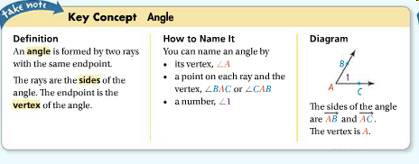
Measuring Angles
When you name angles using three points, the vertex MUST go in the middle.

Slide 4

Measuring Angles
The interior of an angle is the region containing all of the points between the two sides of the angle. The exterior of an angle is the region containing all of the points outside of the angle.

Slide 5

Measuring Angles
Problem 1:
What are the two other names for <1?
What are the two other names for <KML?
Would it be correct to name any of the angles <M? Explain!!

Slide 6

Measuring Angles
One way to measure the size of an angle is in degrees. To indicate the measure of an angle, write a lowercase m in front of the angle symbol.
In the diagram, the measure of <A is 62. You write this as m<A = 62.

Slide 7
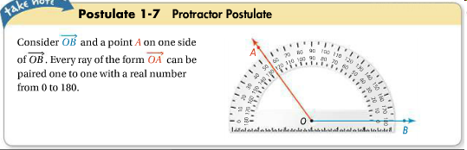
Measuring Angles
The Protractor Postulate allows you to find the measure of an angle.

Slide 8
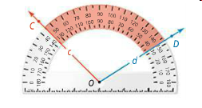
Measuring Angles
The measure of <COD is the absolute value of the difference of the real numbers paired with Ray OC and Ray OD.

Slide 9
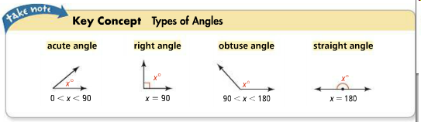
Measuring Angles
Classifying Angles:
You tell me:
ACUTE RIGHT
OBTUSE STRAIGHT

Slide 10
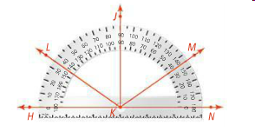
Measuring Angles
Problem 2:
What are the measures of <LKN, JKL, and JKN? Classify each angle as acute, right, obtuse, or straight.

Slide 11

Measuring Angles
Angles with the same measure are congruent angles. This means that if m<A = m<B,
then <A <B.
You can mark angles with arcs to show that they are congruent. If there is more than one set of congruent angles, each set is marked with the same number of arcs.

Slide 12
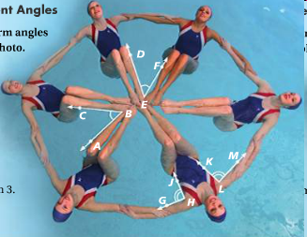
Measuring Angles
Problem 3:
Synchronized swimmers form angles with their bodies, as shown in the photo. If m<GHJ = 90, what is m<KLM?

Slide 13
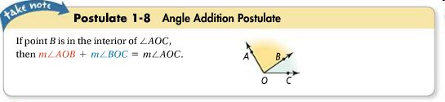
Measuring Angles

Slide 14

Measuring Angles
Problem 4:
If m<RQT = 155, what are m<RQS and m<TQS?

Slide 15

Measuring Angles
Problem 5:
<DEF is a straight angle. What are m<DEC and m<CEF?

