Slide 1
Nets and Drawings for Visualizing Geometry
UNIT 1 LESSON 1

Slide 2
Nets and Drawings for Visualizing Geometry
Students will be able to:
make nets and drawings of three-dimensional figures.
Key Vocabulary:
net
isometric drawing
orthographic drawing

Slide 3
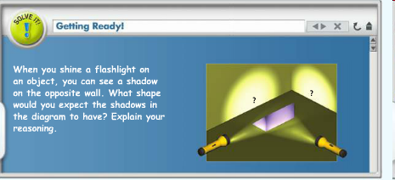
Nets and Drawings for Visualizing Geometry

Slide 4
Nets and Drawings for Visualizing Geometry
In the Solve It, you had to “see” the projection of one side of an object onto a flat surface. Visualizing figures is a key skill that you will develop in geometry.

Slide 5
Nets and Drawings for Visualizing Geometry
You can represent a three dimensional object with a two-dimensional figure using special drawing techniques.
A NET is a two-dimensional diagram that you can fold to form a three-dimensional figure. A net shows all of the surfaces of a figure in one view.

Slide 6

Nets and Drawings for Visualizing Geometry
Problem 1:
The net at the right folds into the cube shown beside it. Which letters will be on the top and front of the cube?
How can you see the 3-D figure? Visualize folding the net at the seams so that the edges join together. Track the letter positions by seeing one surface move in relation to another.

Slide 7
Nets and Drawings for Visualizing Geometry
Problem 1:
How can you determine by looking at the net that surface E and surface F will be opposite one another in the cube?
If the cube were turned one quarter-turn counterclockwise without lifting the bottom surface, which surface would be at the front of the cube?

Slide 8
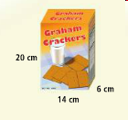
Nets and Drawings for Visualizing Geometry
Problem 2:
What is the net for the graham cracker box to the right? Label the net with its dimensions.

Slide 9

Nets and Drawings for Visualizing Geometry
Problem 2:
What is a net for the figure at the right? Label the net with its dimensions.
Is there another possible net
for the figure?

Slide 10
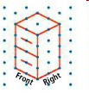
Nets and Drawings for Visualizing Geometry
An ISOMETRIC DRAWING shows a corner view of a three dimensional figure. It allows you to see the top, front, and side of the figure. You can draw an isometric drawing on isometric dot paper. The simple drawing of a file cabinet at the right is an isometric drawing.
A net shows a 3-D figure as a folded
out flat surface. An isometric drawing
shows a 3-D figure using slanted lines
to represent depth.

Slide 11
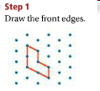
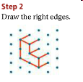
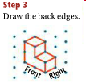

Nets and Drawings for Visualizing Geometry
Problem 3:
What is an isometric drawing of the cube structure at the right?

Slide 12
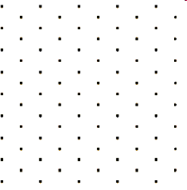

Nets and Drawings for Visualizing Geometry
Problem 3:
What is an isometric drawing of the cube structure at the right?

Slide 13
Nets and Drawings for Visualizing Geometry
An orthographic drawing is another way to represent a 3-D figure. An orthographic drawing shows three separate views, a top view, a front view, and a right-side view.
Although an orthographic drawing may take more time to analyze, it provides unique information about the shape of a structure.

Slide 14
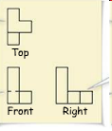

Nets and Drawings for Visualizing Geometry
Problem 4:
What is the orthographic drawing for the isometric drawing at the right?
Solid lines show visible edges.
An isometric drawing shows the same three views.
Dashed lines show hidden edges.

Slide 15

Nets and Drawings for Visualizing Geometry
Problem 4:
What is the orthographic drawing for the isometric drawing at the right?

