Slide 1
Measuring Angles
Unit 1 Lesson 4

Slide 2
Measuring Angles
Students will be able to:
measure, compare and classify angles.
Key Vocabulary
Angle and its measurement
Sides and vertex of an angle
Acute, Obtuse, Right and Straight angles
Congruent angles

Slide 3
Measuring Angles
An angle is a measure of the turn between two lines that have a
common end point. The rotation is measured in the anti-clockwise
direction.
The two lines form the sides of an angle.
The point where two lines are meeting is called the vertex.
The angle is represented by a symbol along with a letter.
Sides
Vertex
A

Slide 4
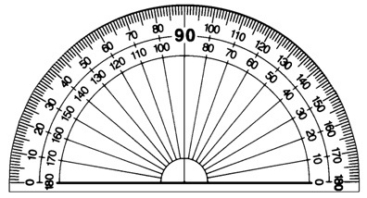
Measuring Angles
The measurement of the angle is done using a protractor. The unit of measuring angle is degrees (°).
If the angle has one of its sides horizontal, then align that side with 0 degrees on the protractor and read the angle for the other side of the angle.
If no side is horizontal, then the angle is the difference of the measurements the two lines give on the protractor.

Slide 5
Measuring Angles
Problem: 1
Measure the angle A given below and write the answer in degrees.
A
Since one of the sides is horizontal, we align this side with 0 degrees and read the angle for the second side.
60°
The angle A is 60°

Slide 6
Measuring Angles
Based on the measure of an angle, it can be classified into four types: 1. Acute angles are the angles whose measures are less than 90 degrees. 2. Right angle is the angle whose measure is exactly 90 degrees. 3. Obtuse angles are the angles whose measures are greater than 90 degrees. 4. Straight angle is the angle whose measure is exactly 180 degrees.

Slide 7
Measuring Angles
Acute angle
Obtuse angle
Right angle
Straight angle

Slide 8
Measuring Angles
Two angles are said to be congruent if the have the same measures.
B
A
The angles A and B are congruent i.e. A $≅$ B

Slide 9
Measuring Angles
An angle bisector is a line that divides an angle into two equal parts.
The line AD bisects the angle CAB or (angle A) in two equal parts and is called the angle bisector.
C
D
A
B

Slide 10
Measuring Angles
Problem: 2
Draw an angle bisector of the right angle.
C
D
A
B
The line AD bisects the right angle into two equal parts. Each bisected angle is 45°.

